Slide 1
The STACK, Infix-prefix-postfix and Recursion
Unit – 1.2, 1.3 and 1.4

Slide 2
The STACK

Slide 3
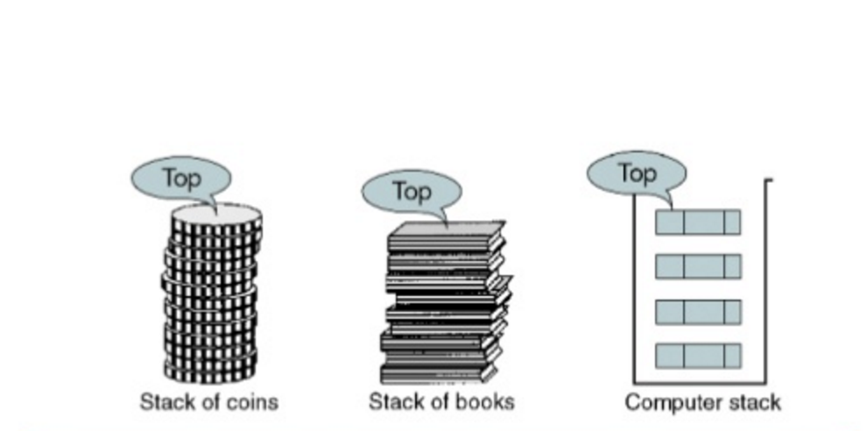
Simple as it sounds
Fig. stack of items

Slide 4
Definition
A stack is an ordered collection of items into which new items may be inserted and from which items may be deleted at one end, called the top of the stack.
Stack is a linear data structure where all the insertions and deletions are done at end rather than in the middle.
Stacks are also called Last in First Out (LIFO) lists.

Slide 5
Intro
We may come across situations, where insertion or deletion is required only at one end, either at the beginning or end of the list.
The suitable data structures to fulfil such requirements are stacks and queues.
For ex. a stack of plates, a stack of coins, a stack of books etc.

Slide 6
Stack as an abstract data type
A stack of elements of type T is a finite sequence of elements together with the operations
  CreateEmptyStack(S): create or make stack S be an empty stack
  Push(S,x): Insert x at one end of the stack, called its top
  Top(S): If stack S is not empty; then retrieve the element at its top
  Pop(S): If stack S is not empty; then delete the element at its top
  IsFull(S): Determine if S is full or not. Return true if S is full stack; return false otherwise
  IsEmpty(S): Determine if S is empty or not. Return true if S is an empty stack; return false otherwise.

Slide 7
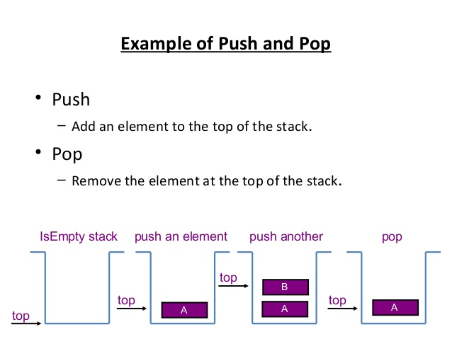

Slide 8
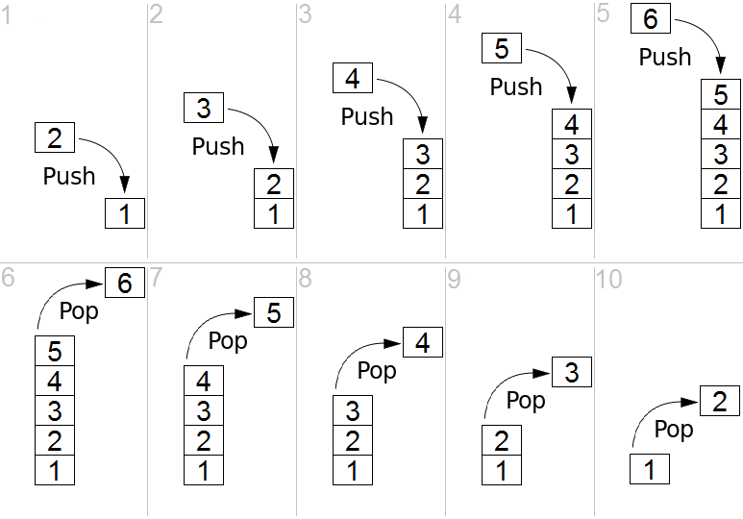
Example of Push Pop

Slide 9
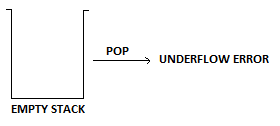
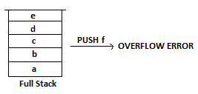
Thing to consider
Stack underflow happens when we try to pop (remove) an item from the stack, when nothing is actually there to remove.
Stack overflow happens when we try to push one more item onto our stack than it can actually hold.

Slide 10
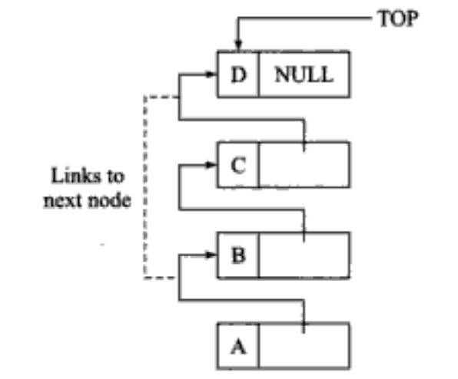
Stack As a Linked List
The stack as linked list is represented as a single linked list.
Each node in the list contains data and a pointer to the next node.
The structure defined to represent stack is as follows:
struct node{
int data;
node *next;
};
Fig. Stack as a linked list

Slide 11
Infix, Postfix and Prefix

Slide 12
Infix, Postfix and Prefix
2+3 <operand><operator><operand>
A-b
(P*2)
Operands are basic objects on which operation is performed
INFIX
<operand><operator><operand>
(2+3) * 4 (2+3) * 4
(P+Q)*(R+S) (P+Q) * (R+S)
Common expressions

Slide 13
Infix
What about 4+6*2 and what about 4+6+2
To clear ambiguity we remember school Mathematics
Order of precedence
  Parentheses (Brackets)
  Order (Exponents)
  Division
  Multiplication
  Addition
  Subtraction
So 4+6*2 | 2*6/2 -3 +7 | {(2*6)/2}-(3+7)
=4+12 | = 2*3-3+7 | = ???
=16 | = 6-3+7 | = ??
| = 3+7=10 | = ?

Slide 14
Prefix (polish notation)
In prefix notation the operator proceeds the two operands. i.e. the operator is written before the operands.
<operator><operand><operand>
infix | prefix
2+3 | +23
p-q | -pq
a+b*c | +a*bc

Slide 15
Postfix (Reverse Polish Notation)
In postfix notation the operators are written after the operands so it is called the postfix notation (post means after).
<operand><operand><operator>
infix | prefix | postfix
2+3 | +23 | 23+
p-q | -pq | pq-
a+b*c | +a*bc | abc*+
Human-readable
Good for machines

Slide 16
Conversion of Infix to Postfix Expression
While evaluating an infix expression, there is an evaluation order according to which the operations are executed
  Brackets or Parentheses
  Exponentiation
  Multiplication or Division
  Addition or Subtraction
The operators with same priority are evaluated from left to right.
Eg:
  A+B+C means (A+B)+C

Slide 17
Evaluation of Prefix and Postfix Expressions
Suppose an expression
a*b+c*d-e
We can write this as:
{(a*b)+(c*d)}-e
As we want to change it into postfix expression
{(ab*)+(cd*)}-e
{(ab*)(cd*)+}-e
{(ab*)(cd*)+} e-
Final form
ab*cd*+e-

Slide 18
Evaluation of Postfix Expressions
Suppose we have a postfix expression
ab*cd*+e-
And we want to evaluate it so lets say
a=2, b=3,c=5,d=4,e=9
We can solve this as,
2 3 * 5 4 * + 9 – <operand><operand><operator>
6 5 4 * + 9 –
6 20 + 9 –
26 9 –
17

Slide 19
Evaluation of Postfix Expressions
From above we get,
2 3 * 5 4 * + 9 –
EvaluatePostfix(exp)
{
create a stack S
for i=0 to length (exp) -1
{
if (exp[i] is operand)
PUSH(exp[i])
else (exp[i] is operator)
op2 <- pop()
op1 <- pop()
res– Perform(exp[i],op1,op2)
PUSH(res)
}
return top of STACK
}
3
2
Stack

Slide 20
Evaluation of Prefix expressions
An expression: 2*3 +5*4-9
Can be written as:
{(2*3)+(5*4)}-9
{(*2 3)+(*5 4)}-9
{+(*2 3) (*5 4)}-9
-{+(*2 3) (*5 4)}9
We can get Rid of Paranthesis
-+*2 3 *5 4 9

Slide 21
Evaluation of Prefix expressions
We have to scan it from right
-+*2 3 *5 4 9
5
6
4
20
26
9
9
9
17
Stack
Stack
Stack
Stack

Slide 22
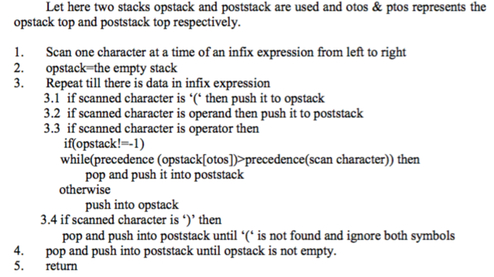
Algorithm to convert Infix to Postfix

Slide 23
Examples:
A * B + C becomes A B * C +
NOTE:
When the '+' is read, it has lower precedence than the '*', so the '*' must be printed first.
current symbol | Opstack | Poststack
A |  | A
* | * | A
B | * | AB
+ | + | AB* {pop and print the '*' before pushing the '+'}
C | + | AB*C
 |  | AB*C+

Slide 24
Examples:
2. A * (B + C) becomes A B C + *
NOTE:
Since expressions in parentheses must be done first, everything on the stack is saved and the left parenthesis is pushed to provide a marker.
When the next operator is read, the stack is treated as though it were empty and the new operator (here the '+' sign) is pushed on.
Then when the right parenthesis is read, the stack is popped until the corresponding left parenthesis is found.
Since postfix expressions have no parentheses, the parentheses are not printed.
current symbol | Opstack | Poststack
A |  | A
* | * | A
( | *( | A
B | *( | AB
+ | *(+ | AB
C | *(+ | ABC
) | * | ABC+
 |  | ABC+*

Slide 25
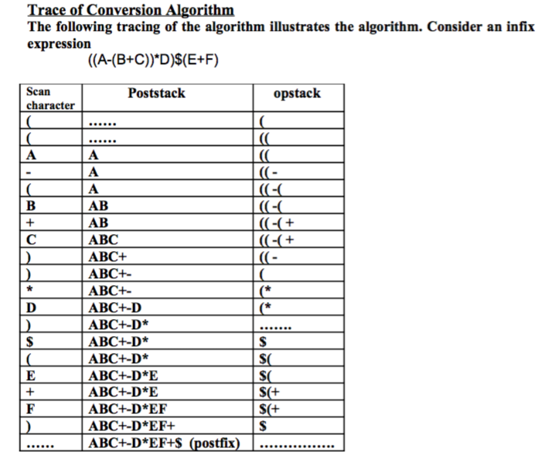

Slide 26
Recursion

Slide 27
Recursion
Recursion is a process by which a function calls itself repeatedly, until some specified condition has been satisfied
The process is used for repetitive computations in which each action is stated in terms of a previous result.
To solve a problem recursively, two conditions must be satisfied.
  First, the problem must be written in a recursive form
  Second the problem statement must include a stopping condition

Slide 28
Factorial of an integer number using recursive function
#include<stdio.h>
#include<conio.h>
int main(){
int n, fact;
scanf(“%d”,&n);
fact=factorial(n);
printf(“The factorial of %d!=%d”,n,fact);
getch();
Return 0;
}
int factorial(int n){
if(n==0){
return 1;
}
else{
return n*factorial(n-1);
}
Factorial(5)=
5*Factorial(4)=
5*(4*Factorial(3))=
5*(4*(3*Factorial(2)))=
5*(4*(3*(2*Factorial(1))))= 5*(4*(3*(2*(1*Factorial(0)))))=
5*(4*(3*(2*(1*1))))= 5*(4*(3*(2*1)))=
5*(4*(3*2))= 5*(4*6)= 5*24=
120

Slide 29
Recursion Pros and Cons
Pros
  The code may be much easier to write.
  To solve some problems which are naturally recursive such as tower of Hanoi.
Cons
  Recursive functions are generally slower than non-recursive functions.
  May require a lot of memory to hold intermediate results on the system stack.
  It is difficult to think recursively so one must be very careful when writing recursive functions.

Slide 30

Tower of Hanoi Problem

Slide 31
Tower of Hanoi Problem
The mission is to move all the disks to some another tower without violating the sequence of arrangement.
The below mentioned are few rules which are to be followed for tower of hanoi −
  Only one disk can be moved among the towers at any given time.
  Only the "top" disk can be removed.
  No larger disk can sit over a smaller disk.

Slide 32
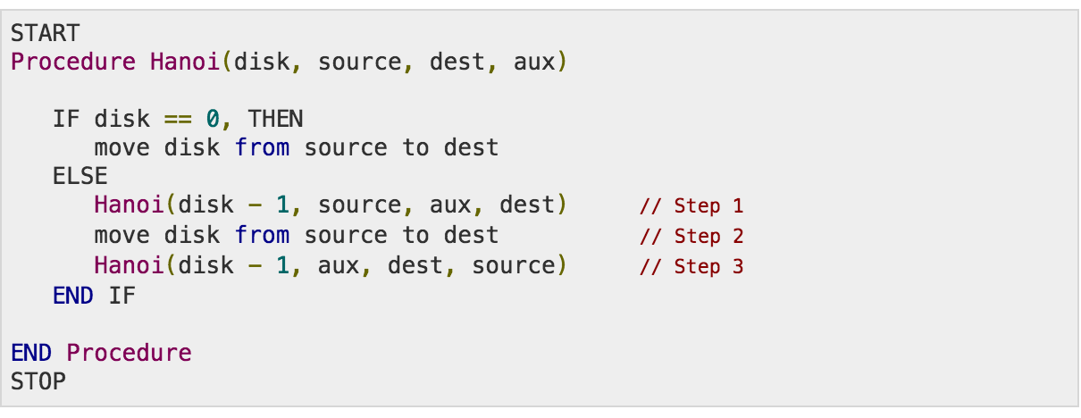
A recursive algorithm for Tower of Hanoi can be driven as follows −

Slide 33
THE END

